Slide 1
Error Detection and Correction
Welcome to our
presentation
COURSE TEACHER: MR. SHAHADAT HOSSAIN
COURSE CODE: CSE-225
COURSE TITLE: DATA COMMUNICATION
SECTION: 61_X
DEPARTMENT OF CSE

Slide 2








MEET THE TEAM
MD. NEROB HAWLADER
AMIT KUMAR GHOSH
SADIQUL HAQUE SADIB
MD. JAHIDUL ISLAM
221-15-5239
221-15-4650
221-15-4863
221-15-4885
JARIN TASNIM SHOWRIN
LAMIA AKTER LIZA
SIAM AKTER MIM
TANJID HASAN TURKY
221-15-4547
221-15-5100
221-15-5924
221-15-5916

Slide 3
Table of contents
What is error
Types of error
Error detection & Correction
Error Detection Techniques
Hamming code
Check-sum
Cyclic redundancy check

Slide 4
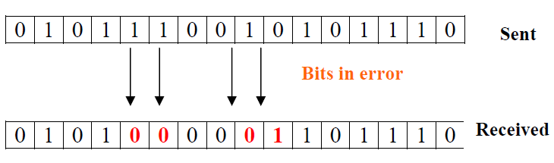
What is Error?
Error is a condition when the output information does not match with the input information. During transmission, digital signals suffer from noise that can introduce errors in the binary bits travelling from one system to other. That means a 0 bit may change to 1 or a 1 bit may change to 0.

Slide 5
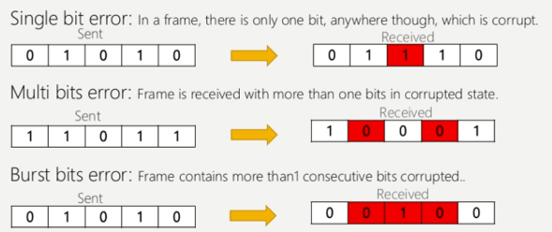
Types of Error
1.Single bit: A single bit gets corrupted during transmission . 2.Multi bit: Bore than one bit gets corrupted during transmission. 3.Brust bit: A number of continued bits get corrupted during transmission.

Slide 6
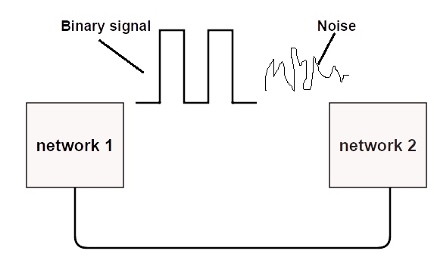
Error detection & Correction
Error Detection:
Error detection is the detection of errors caused by noise or other impairments during transmission from the transmitter to the receiver.
Error Correction:
Error correction is the detection of errors and reconstruction of the original, error-free data..

Slide 7
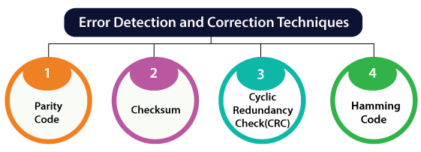
Error Detection Techniques
1. Hamming code 2. Checksum 3. Cyclic Redundancy check

Slide 8
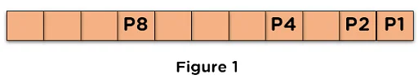
Hamming code
What is Hamming Code?
Hamming code is a liner code that is useful for error detection up to two immediate bit errors. It is capable of single-bit errors.
How to check if there’s any Error using Hamming Code?
To solve the data bit issue with the hamming code method, some steps need to be followed:
Step 1 - The position of the data bits and the number of redundant bits in the original data. The number of redundant bits is deduced from the expression [2^r >= d+r+1].
Step 2 - Fill in the data bits and redundant bit, and find the parity bit value using the expression [2^p, where, p - {0,1,2, …… n}].

Slide 9
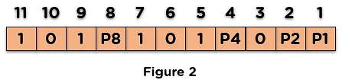
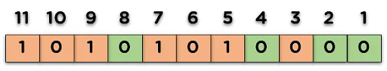
Hamming code
Step 3 - Fill the parity bits and data bits obtained from the original data.
Step 4 - Check the received data using the parity bit and detect any error in the data, and in case damage is present, use the parity bit value to correct the error.
Next, we will solve an example using hamming code to clarify any doubts regarding the working steps.
Original Data:

Slide 10
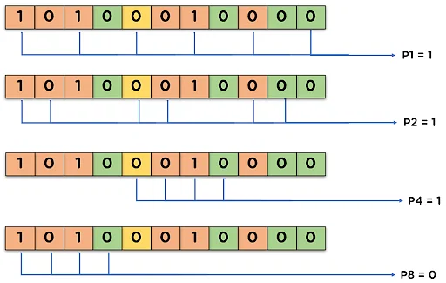
Hamming code
Error Detecting and Correction of the Data Received:
Assume that during transmission, the data bit at position 7 is changed from 1 to 0. Then by applying the parity bit technique, we can identify the error:
Odd Parity bits - In this parity type, the total number of 1’s in the data bit should be odd in count, then the parity value is 0, and the value is 1.
Even Parity bits - In this parity type, the total number of 1’s in the data bit should be even in count; then the parity value is 0, and the value is 1.
_{p1} = parity(1, 3, 5, 7, 9, 11 and so on)
_{p2} = parity(2, 3, 6, 7, 10, 11 and so on)
_{p3} = parity(4-7, 12-15, 20-23 and so on)
Here:
P1=1, P2=1, P4=1, P8=0
0111 = 7 (binary to decimal conversion)
7 number bit has error.

Slide 11
Check-sum
Checksums:
This is a block code method where a checksum is created based on the data values in the data blocks to be transmitted using some algorithm and appended to the data. When the receiver gets this data, a new checksum is calculated and compared with the existing checksum. A non-match indicates an error.
Error Detection by Checksums:
For error detection by checksums, data is divided into fixed sized frames or segments.
Sender’s End − The sender adds the segments using 1’s complement arithmetic to get the sum. It then complements the sum to get the checksum and sends it along with the data frames.
Receiver’s End − The receiver adds the incoming segments along with the checksum using 1’s complement arithmetic to get the sum and then complements it.
If the result is zero, the received frames are accepted; otherwise they are discarded.

Slide 12
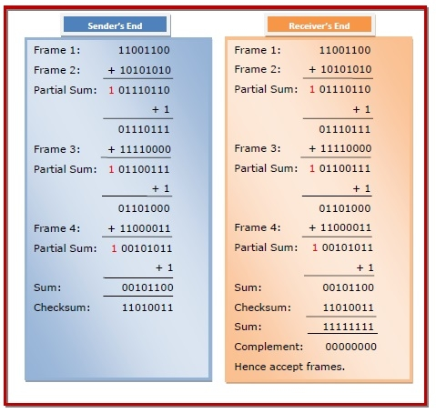
Check-sum
Example:
Suppose that the sender wants to send 4 frames each of 8 bits, where the frames are 11001100, 10101010, 11110000 and 11000011.

Slide 13
Cyclic Redundancy Check
Cyclic Redundancy Check (CRC):
The CRC is a network method designed to detect errors in the data and information transmitted over the network. This is performed by performing a binary solution on the transmitted data at the sender’s side and verifying the same at the receiver’s side.
Sender Side:
The first step is to add the no. of zeroes to the data to be sent, calculated using k-1 (k - is the bits obtained through the polynomial equation.)
Applying the Modulo Binary Division to the data bit by applying the XOR and obtaining the remainder from the division
The last step is to append the remainder to the end of the data bit and share it with the receiver.

Slide 14
Cyclic Redundancy Check
Receiver Side (Checking for errors in the received data):
To check the error, perform the Modulo division again and check whether the remainder is 0 or not,
If the remainder is 0, the data bit received is correct, without any errors.
If the remainder is not 0, the data received is corrupted during transmission.
Example -
The data bit to be sent is [100100], and the divisor is 1101.
Data bit - 100100
Divisor (k) - 1101
Appending Zeros - (k-1) > (4-1) > 3
Dividend - 100100000

Slide 15
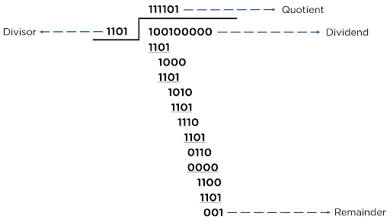
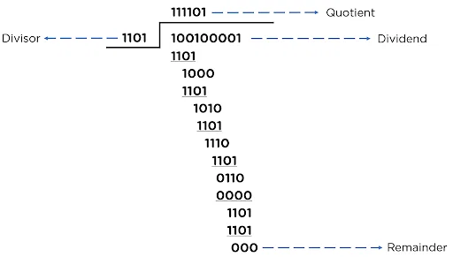



Cyclic Redundancy Check
Original Data bit – 100100
Divisor (k) – 1101. Length=4
Appending Zeros - (k-1) = (4-1) > 3
Sender Side:
Receiver Side:
The Obtained remainder is [000], i.e., zero, which according to the CRC method, concludes that the data is error-free.

Slide 16


Sender Side:
Receiver Side:
THANK YOU
Reference:
https://www.simplilearn.com/tutorials/networking-tutorial/what-is-cyclic-redundancy-check#:~:text=The%20CRC%20is%20a%20network,same%20at%20the%20receiver%27s%20side.
https://www.guru99.com/hamming-code-error-correction-example.html
https://www.slideshare.net/BadrulAlam16/error-detection-and-correction-presentation

